Slide 1


R.N.S INSTITUTE OF TECHNOLOGY
DEPARTMENT OF INFORMATION SCIENCE & ENGINEERING
DBMS PROJECT PRESENTATION
TOPIC : COLLEGE DATA MANAGEMENT SYSTEM
PRESENTED BY :
1RN20IS108
PRAJWAL B P BARLAYA
1RN20IS110
PRAJWAL M
Lab in Charge
Mr. T S Bhagavat Singh
Associate Professor
Dept. of ISE, RNSIT
Guide
Ms.Sunitha K & Ms.Aishwarya G
Prof./Asso. & Prof./Asst. Prof
Dept of ISE, RNSIT
Date : 25-01-2023
Time: 2.30-2.45 pm

Slide 2
AGENDA
Abstract
Introduction
Front end and Back end tools
ER-Diagram
ER to Schema Mapping
Schema Diagram
Tables description with Normalization
Stored Procedures and Triggers
Results
Snapshots
Applications
Conclusion
References

Slide 3
ABSTRACT
The Static website for this project “COLLEGE DATA BASE MANAGEMENT” is built using HTML , CSS and the backend for the project is done using Node Javascript , MySQL Server and the Angular CLI is used as framework for frontend .
The College Data Base Management System helps in registering the student details i.e Admission process . The student can enter his details and selecting the course in which he want to pursue his education . The details of student which he has entered can be downloaded as pdf copy after the registration Process has been completed. The details of students belonging to the particular branch can be viewed by the admin and thus can be sorted further.

Slide 4
INTRODUCTION
The main objective of college management system is to automate all functionalities of a college or university. This project helps to digitize and streamline the day-to-day operations of colleges and universities. From student admission to Fees payment Details and other process of college operations.
College Data Management System gives a straightforward interface to support of study of data, staff information , attendance , admission ,fee , record.
The college database management system needs to create the college database to organize student records and other information about the students.

Slide 5
LITERATURE SURVEY
In the early days of computing, data management and storage were a very new concept for organizations. The traditional approach to data handling offered a lot of the convenience of the manual approach to business processes (e.g. handwritten invoices & account statements, etc.) as well as the benefits of storing data electronically.
Initially, these separate systems were very simple to set up as they mostly mirrored the business process that departments had been doing for years but allowed them to do things faster with less work. However, once the systems were in use for so long, they became very difficult for individual departments to manage and rely on their data because there was no reliable system in place to enforce data standards or management.

Slide 6
Requirements
A. Software requirements:
V S STUDIO
MySQL Server
Postman
Angular CLI
B. Hardware requirements:
Processor : Intel Core i5
RAM : 8GB
Hard Disk:1TB

Slide 7
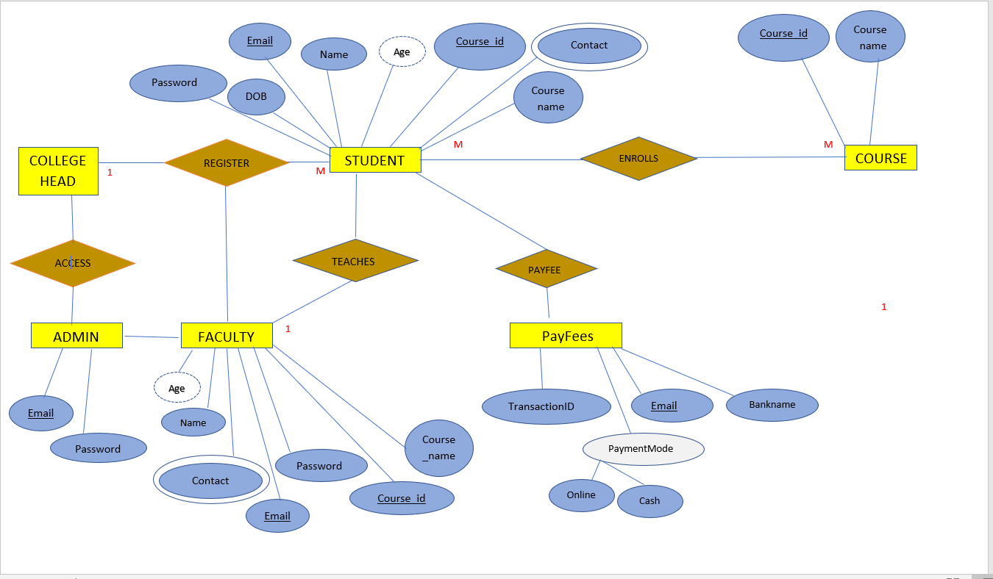
SYSTEM DESIGN
ENTITY RELATIONSHIP DIAGRAM

Slide 8
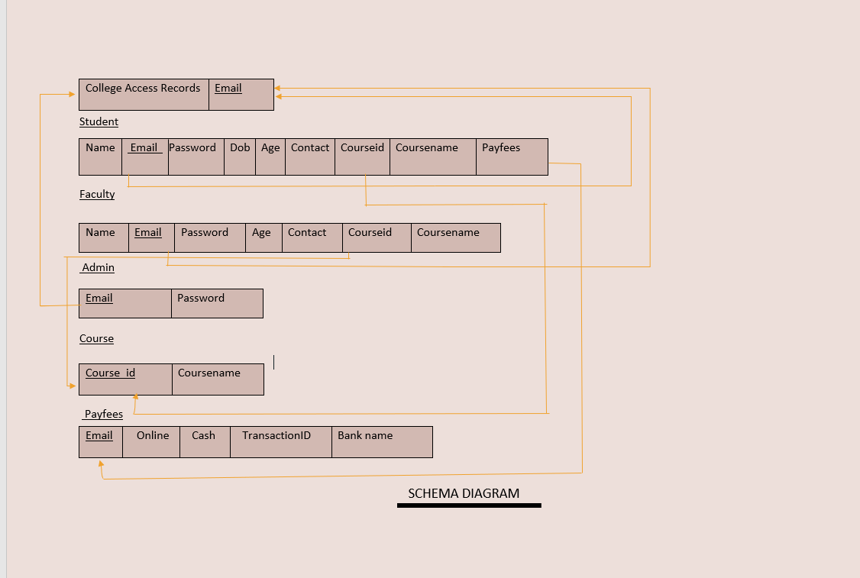
SCHEMA DIAGRAM

Slide 9
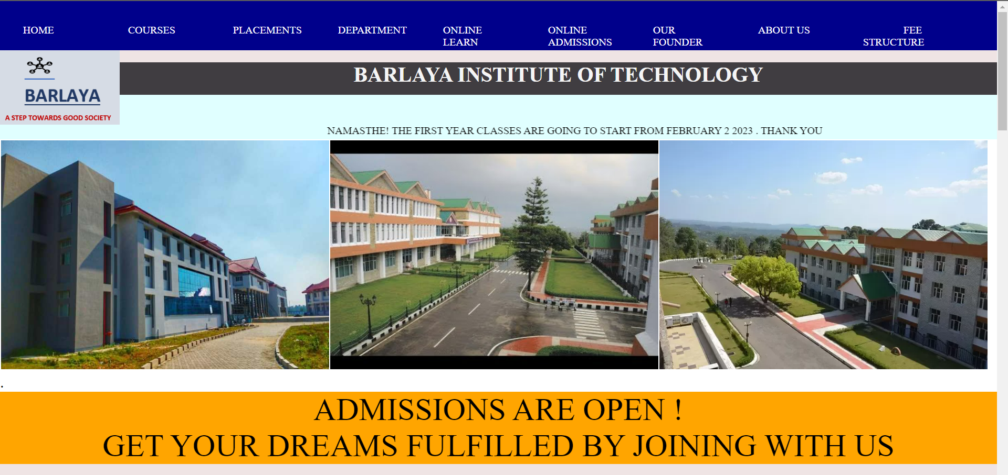
SNAP SHOTS

Slide 10
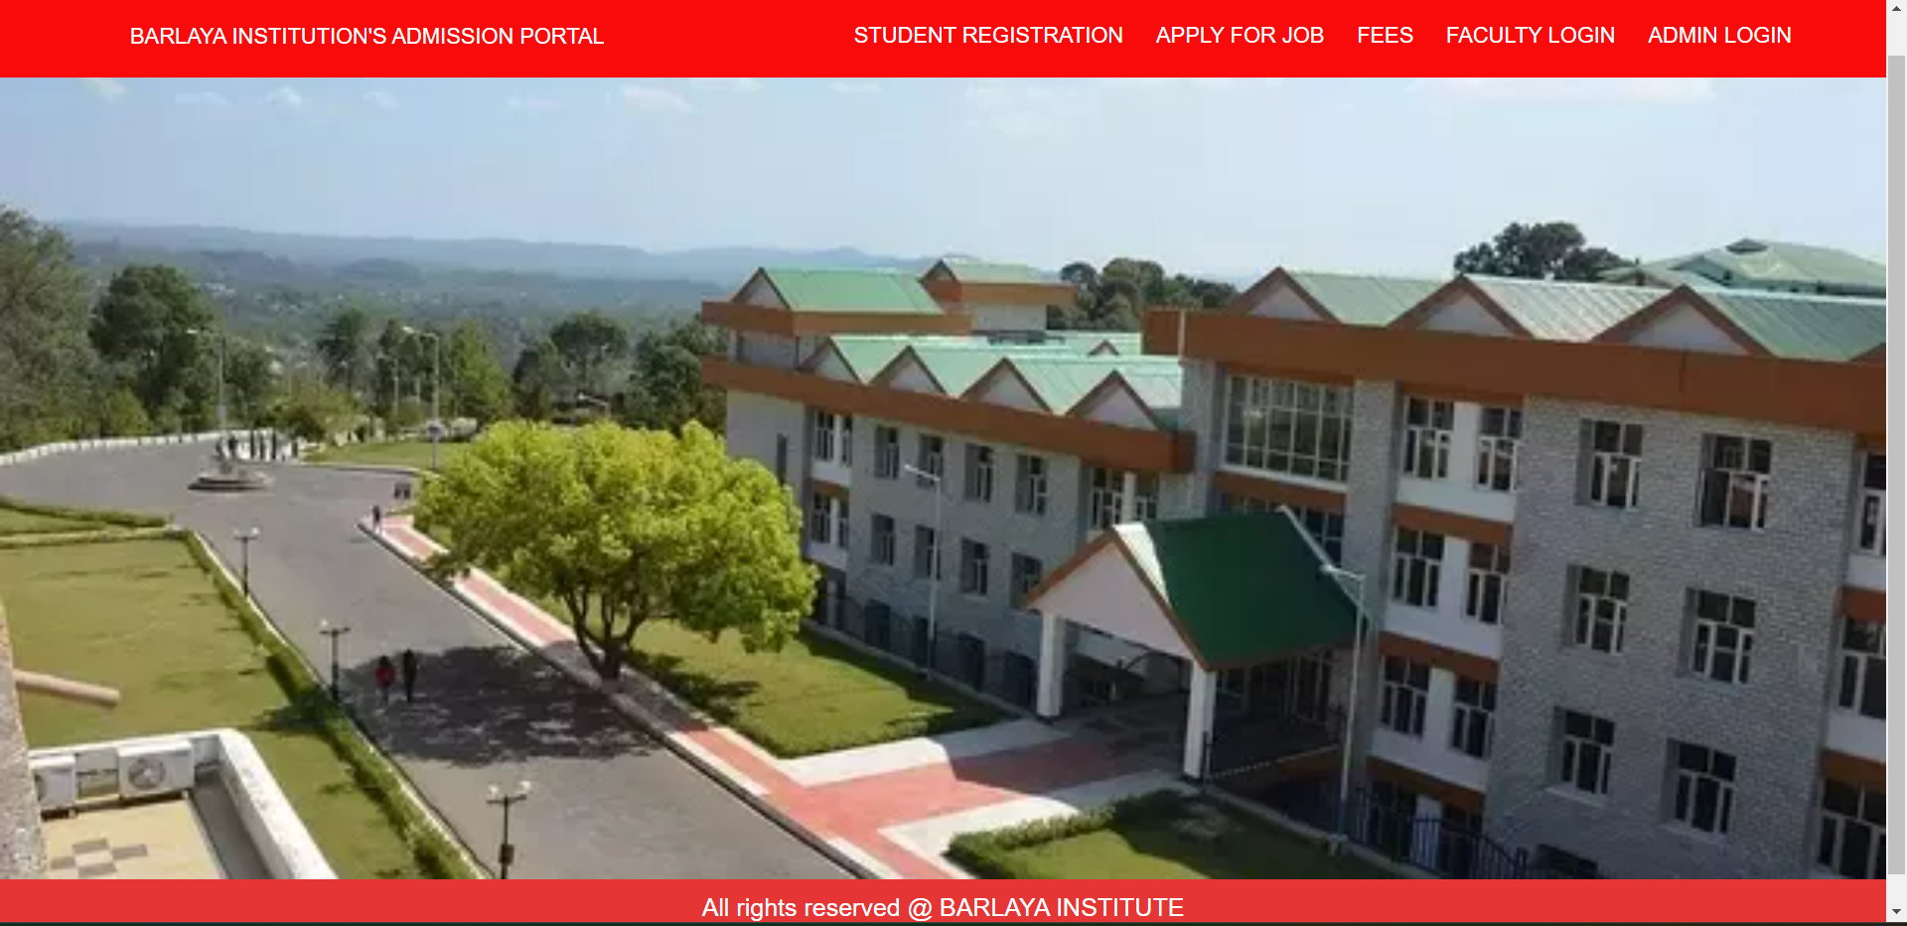
SNAP SHOTS

Slide 11
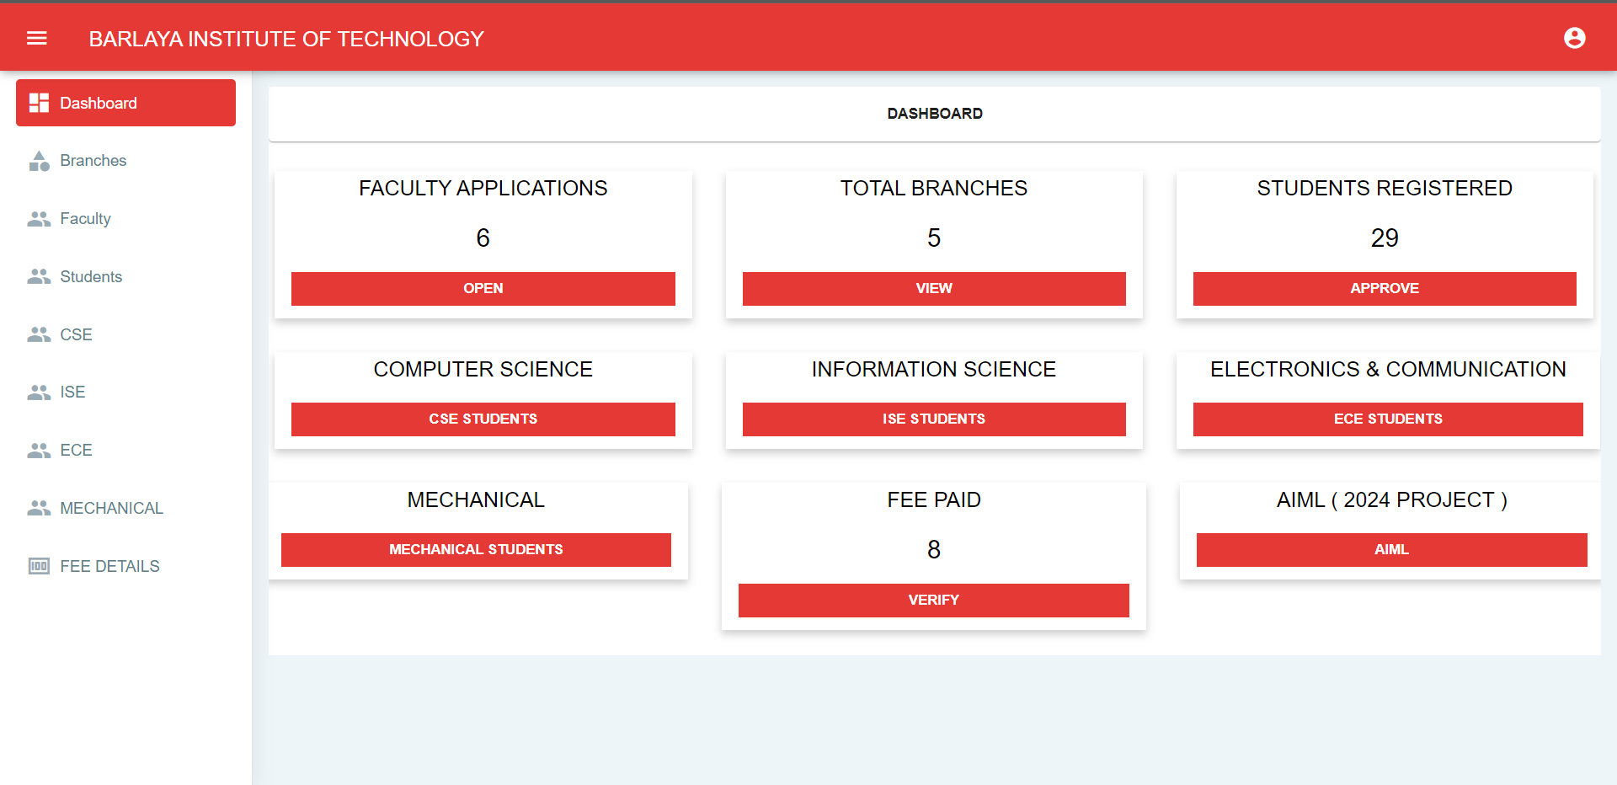
SNAP SHOTS

Slide 12
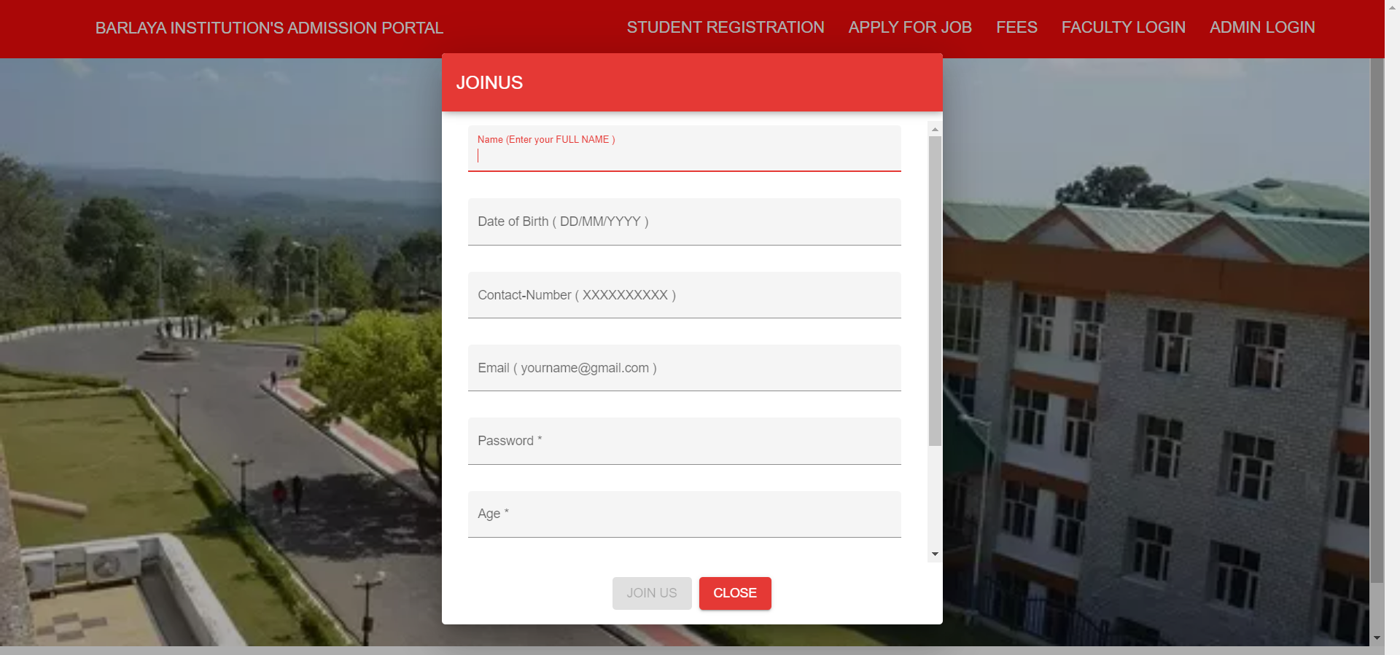
SNAP SHOTS

Slide 13
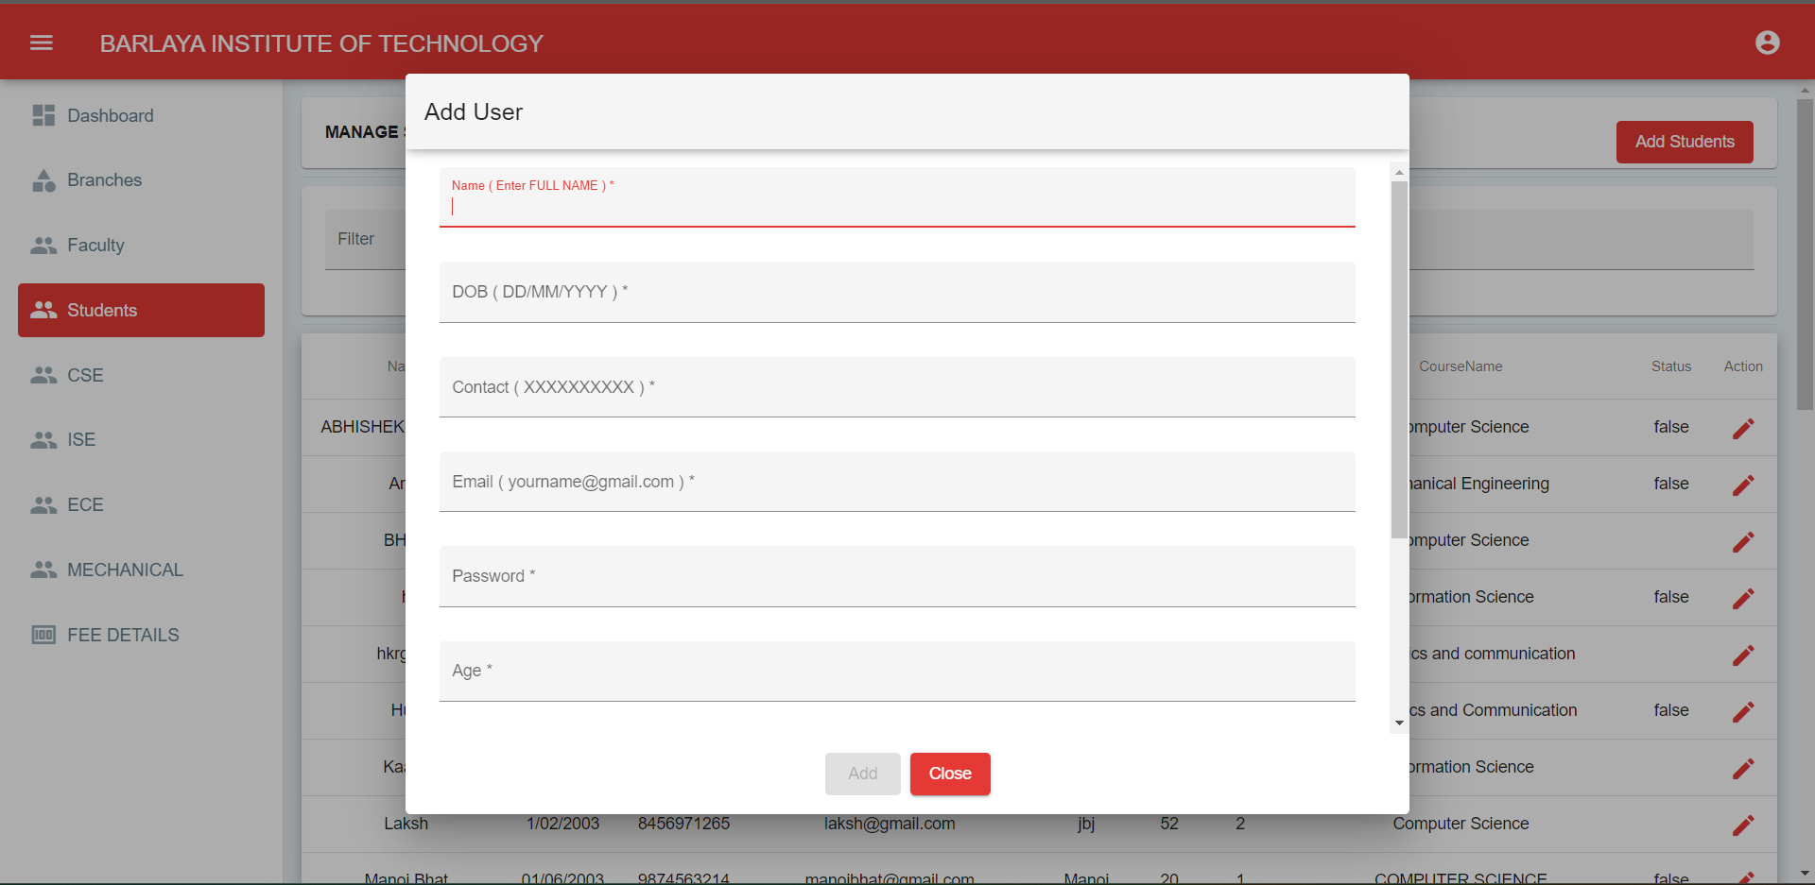
SNAP SHOTS

Slide 14
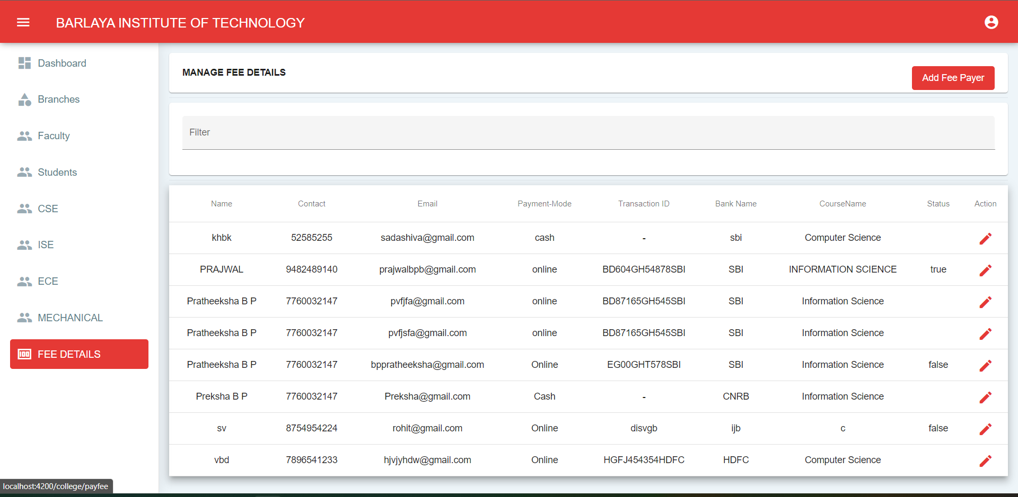
SNAP SHOTS

Slide 15
CONCLUSIONS
The College Database Management has been designed to maintain the records of all the aspects of students with respect to branches selected during admission. This project was designed to model the working of a College website. It contains all the details about the various branches for admission provided by the college for their students.
The database system project includes triggers that allow the admin to get the students details that are newly added by the admin or the student himself. It also includes a stored procedure to select a details of student’s choice. The project provides simple retrieval techniques and easy adding operations thus helping in efficient maintenance of records.

Slide 16
FUTURE ENHANCEMENTS
Just like any other developer this project is the most basic website built using simple tools. We seek to increase the dynamic of the project by adding various other innovations to it. Such innovations would seem possible only with time, which we lack but regardless we strive to complete what we started.
We believe that apart from the present functionalities we can add:
“ONLINE PAYMENT GENERATING PDF” which will recommend various options for payment for student based on his convenience.
“FACILITY TO DOCUMENT UPLOAD DOCUMENTS” so that we can easily access to registered students.
Apart from these changes we are open to various suggestions and hope to implement them soon so that this website can be used by the students and faculties for their needs

Slide 17
REFERENCES
Ramez Elmasri and Shamkant B. Navathe, Fundamentals of Database Systems, PEARSON, Fifth Edition.
Raghu Ramakrishnan and Johannes Gehrke, Database Management Systems, McGRAW HILL, Third Edition.
https://www.w3schools.com/html/
https://www.w3schools.com/css/
https://www.geeksforgeeks.org
www.stackoverflow.com
https://www.postman.com/
https://youtu.be/ZHg2u4QNUdw

Slide 18

THANK YOU

